Slide 1
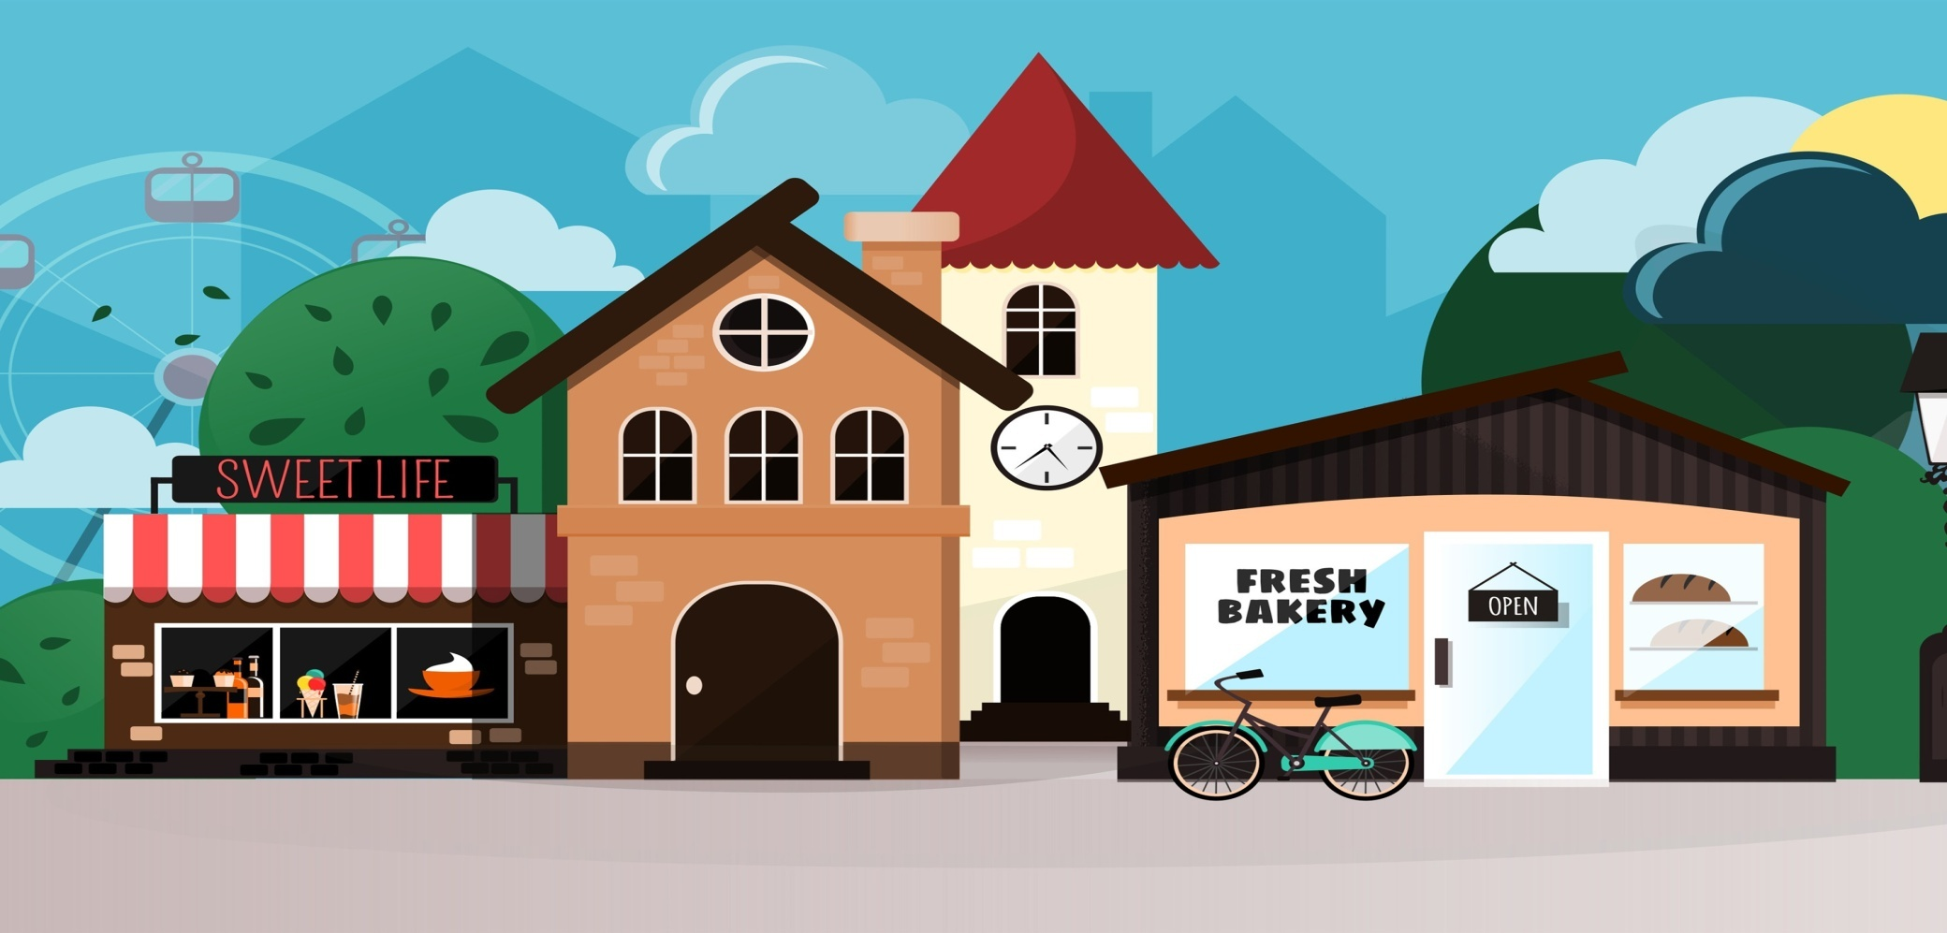
My neighbourhood
Baker’s Library Café Post Office Supermarket
Newsagent’s Chemists Toy Shop Greengrocer’s Bank

Slide 2
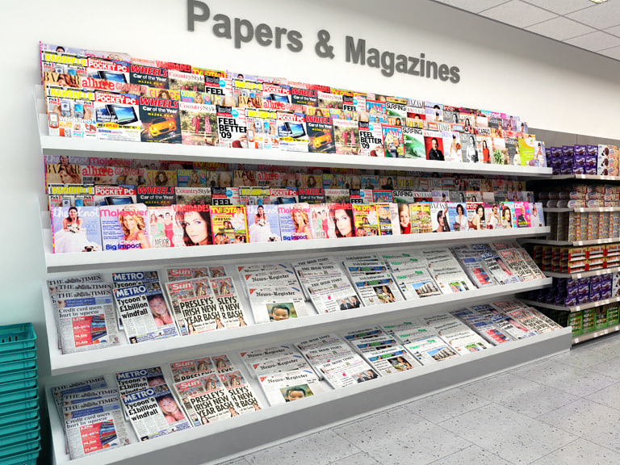
Where can you buy newspapers and magazines?
You can buy … at the …

Slide 3
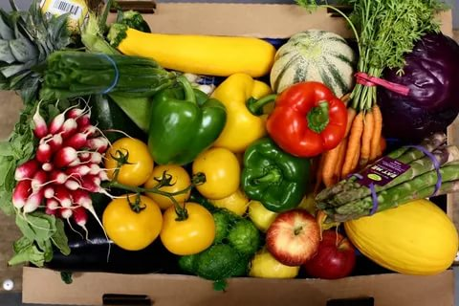
Where can you buy vegetables?
You can buy … at the …

Slide 4
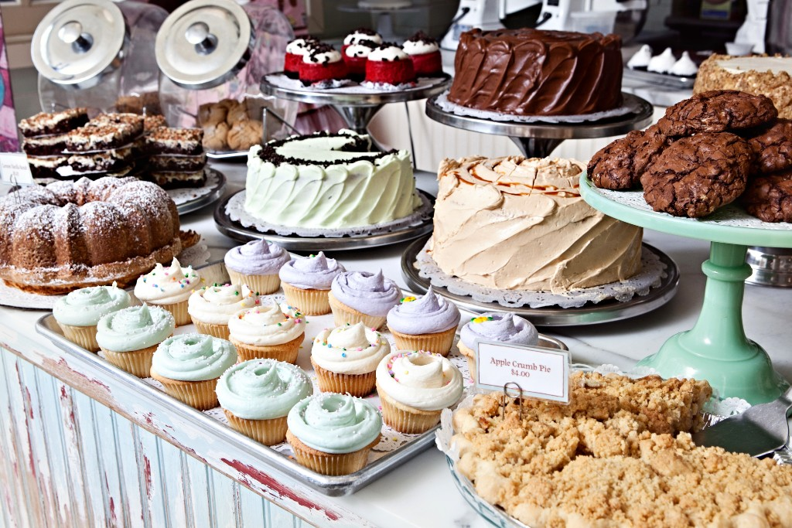
Where can you buy cakes and biscuits?
You can buy … at the …

Slide 5
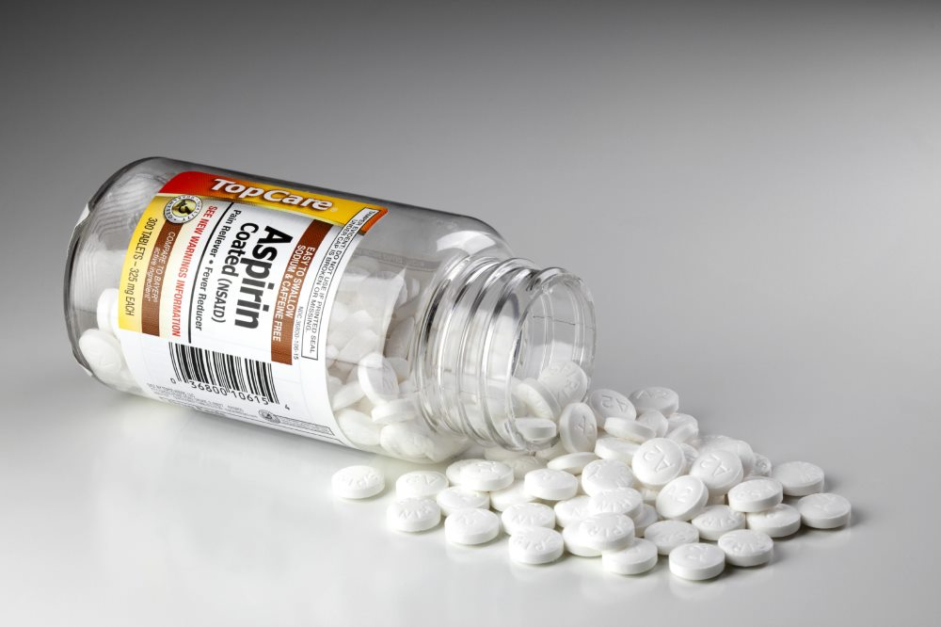
Where can you buy aspirin?
You can buy … at the …

Slide 6
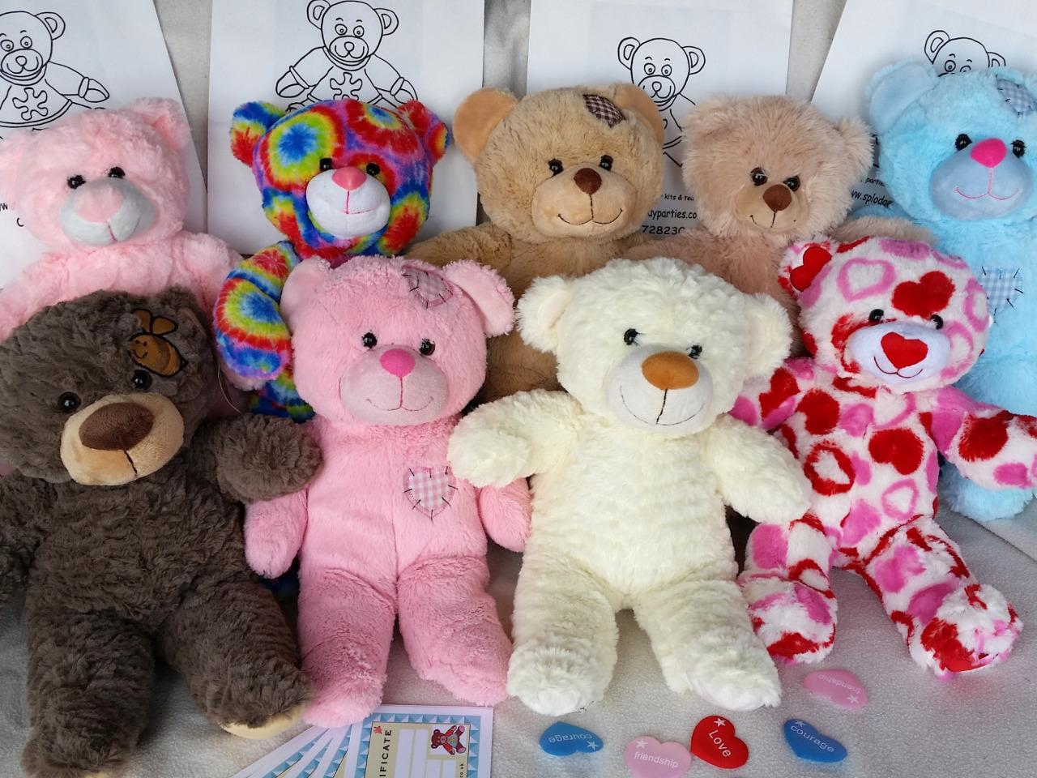
Where can you buy teddy bears?
You can buy … at the …

Slide 7
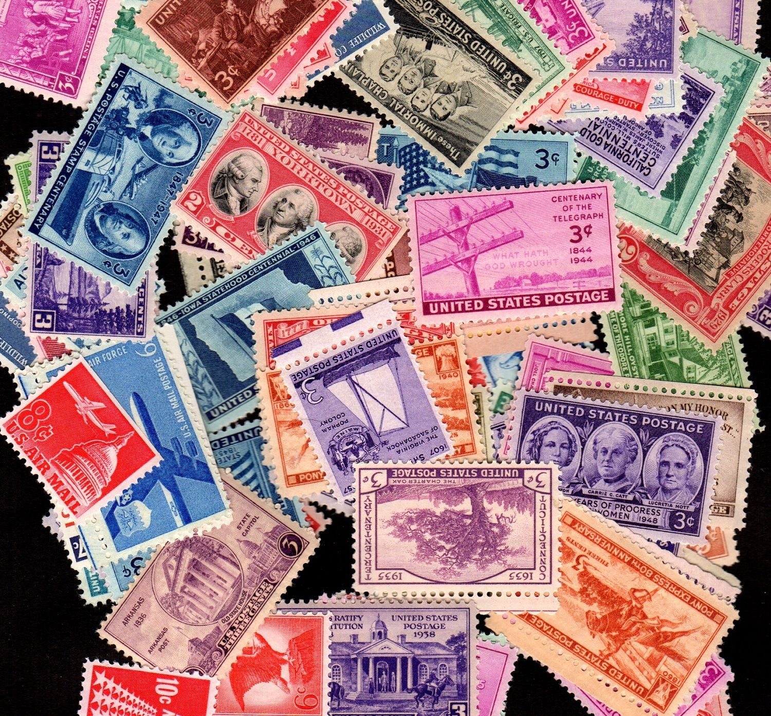
Where can you buy stamps?
You can buy … at the …

Slide 8
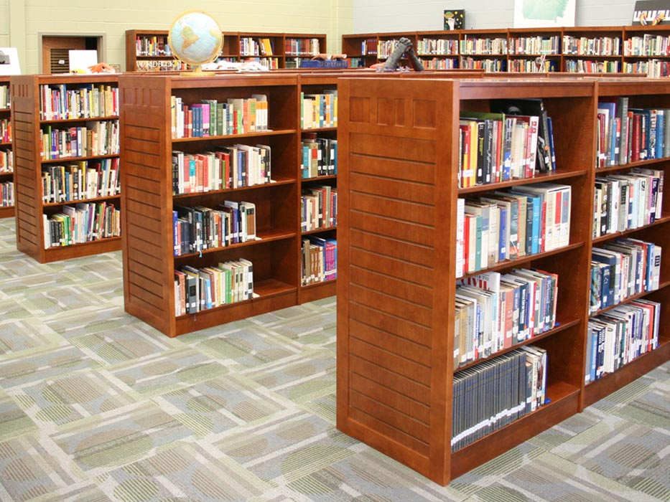
Where can you take a book to read?
You can take … at the …

Slide 9
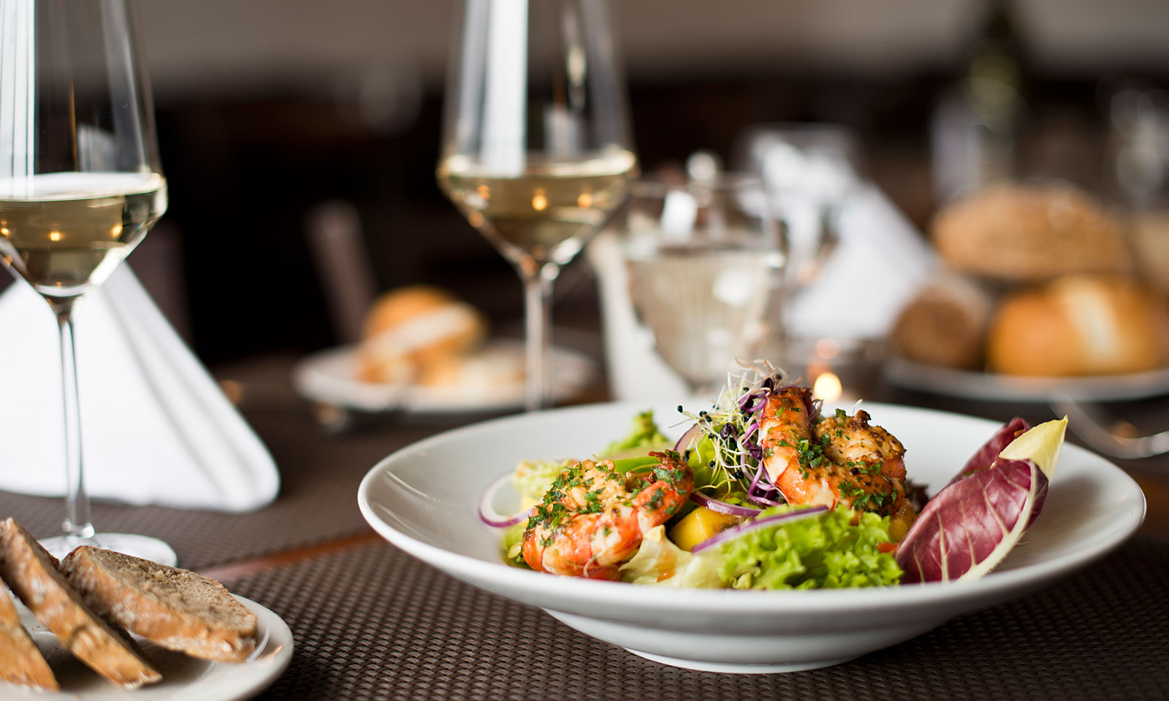
Where can you eat delicious food?
You can eat at the …

Slide 10
Hi! I am looking for the post
office. Do you know where it is?

Slide 11
- Hi! I am looking for the post office. Do you know where it is?
-Yes. It’s right next to the bank, the one
opposite the newsagent’s.

Slide 12
-Hi! I am looking for the post office. Do you know where it is?
-Yes. It’s right next to the bank, the one opposite the newsagent’s.
- Sorry… Is the post office opposite the newsagent’s?

Slide 13
-Hi! I am looking for the post office. Do you know where it is?
-Yes. It’s right next to the bank, the one opposite the newsagent’s.
- Sorry… Is the post office opposite the newsagent’s?
- No, no. The newsagent’s is opposite the bank, and the post office is opposite the supermarket.

Slide 14
-Hi! I am looking for the post office. Do you know where it is?
-Yes. It’s right next to the bank, the one opposite the newsagent’s.
- Sorry… Is the post office opposite the newsagent’s?
- No, no. The newsagent’s is opposite the bank, and the post office is opposite the supermarket.
- And what about the library?

Slide 15
-Hi! I am looking for the post office. Do you know where it is?
-Yes. It’s right next to the bank, the one opposite the newsagent’s.
- Sorry… Is the post office opposite the newsagent’s?
- No, no. The newsagent’s is opposite the bank, and the post office is opposite the supermarket.
- And what about the library?
- It’s behind the chemist’s.

Slide 16
-Hi! I am looking for the post office. Do you know where it is?
-Yes. It’s right next to the bank, the one opposite the newsagent’s.
- Sorry… Is the post office opposite the newsagent’s?
- No, no. The newsagent’s is opposite the bank, and the post office is opposite the supermarket.
- And what about the library?
- It’s behind the chemist’s.
- And what’s that place opposite the chemist’s, next to the post office?

Slide 17
-Hi! I am looking for the post office. Do you know where it is?
-Yes. It’s right next to the bank, the one opposite the newsagent’s.
- Sorry… Is the post office opposite the newsagent’s?
- No, no. The newsagent’s is opposite the bank, and the post office is opposite the supermarket.
- And what about the library?
- It’s behind the chemist’s.
- And what’s that place opposite the chemist’s, next to the post office?
- That’s the coffee shop.

Slide 18
-Hi! I am looking for the post office. Do you know where it is?
-Yes. It’s right next to the bank, the one opposite the newsagent’s.
- Sorry… Is the post office opposite the newsagent’s?
- No, no. The newsagent’s is opposite the bank, and the post office is opposite the supermarket.
- And what about the library?
- It’s behind the chemist’s.
- And what’s that place opposite the chemist’s, next to the post office?
- That’s the coffee shop.

Slide 19
Supermarket
Library
Toy shop
Bank
Post office
Chemist’s
Baker’s
Coffee shop

Slide 20
Supermarket
Library
Toy shop
Bank
Chemist’s
Baker’s
Coffee shop
Post office
The Bank is between the Toy shop and the Chemist’s.

Slide 21
Supermarket
Library
Toy shop
Bank
Chemist’s
Baker’s
Coffee shop
Post office
The Baker’s is next to the Coffee shop.

Slide 22
Supermarket
Library
Toy shop
Bank
Chemist’s
Baker’s
Coffee shop
Post office
The Toy shop is opposite the Library and next to the Bank.

Slide 23
Supermarket
Library
Toy shop
Bank
Chemist’s
Baker’s
Coffee shop
Post office
The Supermarket is opposite the Toy shop.

Slide 24
Supermarket
Library
Toy shop
Bank
Chemist’s
Baker’s
Coffee shop
Post office
The Baker’s is between the Chemist’s and the Coffee shop.

Slide 25
Supermarket
Library
Toy shop
Bank
Chemist’s
Baker’s
Coffee shop
Post office
The Post office is behind the Library.

Slide 26
Hometask
SB p 20 Ex 4

